Slide 1
State of The school
Academy of Our Lady of Mount Carmel
April 12, 2018

Slide 2
Tonight’s agenda
Opening Prayer: Father Dan O’Neill
Welcome: Miss Koval
Tenafly Police Department: Chief Robert Chamberlain
Catholic Identity (Mission/ Community Service/ Carmel Cares/ Parish School Connection)
Communication(Website)
Parent Involvement (Parents Guild Executive Board/Class Parents/
Enrollment and Admissions
Facilities and Campus Upgrades: Mr. Ed McElroy
Technology
Curriculum and Instruction (mapping/teacher evaluations/ resources/ technology)
Enrichment and Opportunities (Athletics/Before/ After/ class trips)
Advancements (Blue Ribbon/ Middle States)
Personnel Changes
Closing Remarks: Father Dan O’Neill

Slide 3
Please join us for prayer
~ Father Dan O’Neill

Slide 4
Our mission
The Academy of Our Lady of Mount Carmel is an educational community with roots in the Roman Catholic faith that teaches Gospel values. Within our Carmelite tradition we are dedicated to helping students see God in themselves, in each other and in the world around them. We strive to educate the whole person – intellectually, spiritually, physically, socially and emotionally – while building a strong foundation of ethical and moral ideals.
OUR PHILOSOPHY
We, the community of the Academy of Our Lady of Mount Carmel, are committed to the Catholic education of our youth. We strive to provide a comprehensive education of experience that develops the spiritual awareness, intellectual talents, personal responsibility and social consciousness of each child. We endeavor to foster the values of servant leadership in our students and staff and are dedicated to educating the mind, heart and spirit of each child with a deep appreciation of the uniqueness of each person.

Slide 5
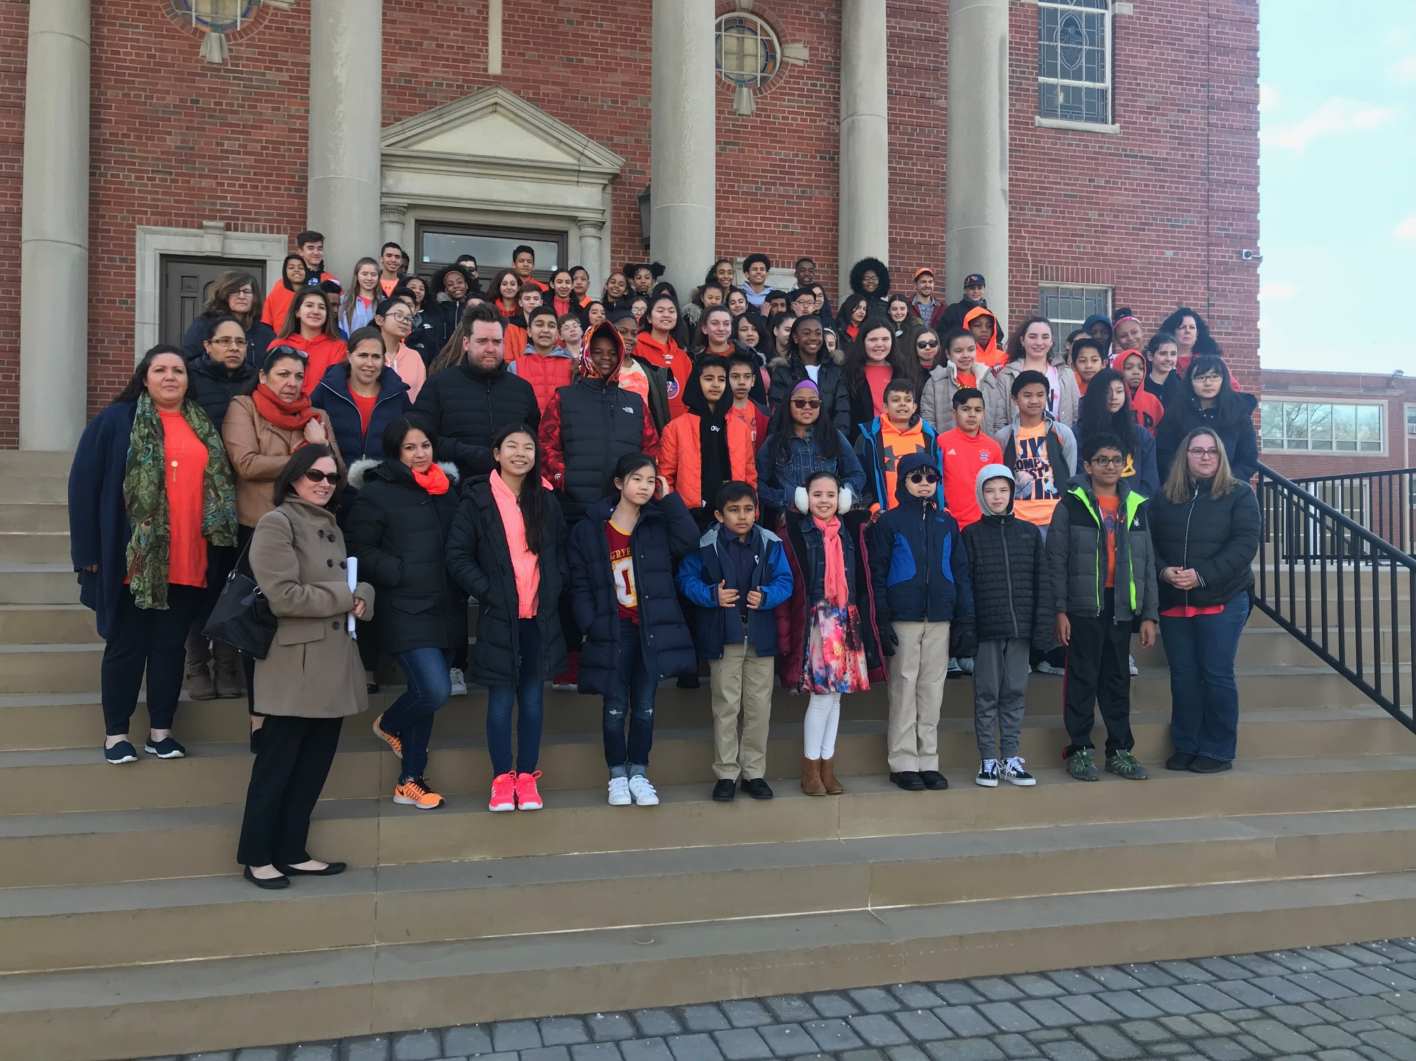
CHIEF ROBERT CHAMBERLAIN
THANK YOU TO THE TENAFLY POLICE DEPARTMENT FOR KEEPING OUR CHILDREN SAFE.
SCHOOL SAFETY
POLICE COMPLIANCE
WEEKLY PATROL
REGULAR COMPLIANCE MEETINGS
OLMC CAMERA SYSTEM
BOGAN COMMUNICATION
FIRE/ SECURITY DRILLS
LEAD PROGRAM: GRADE 6

Slide 6
COMMUNICATION
Website continues to be our Main source of Communication.
OLMC added the Principal’s Monthly Memo.
Monthly Calendar listing all upcoming school activities is located on the Academy website. (printer version available)

Slide 7
…Continued
Parents are encouraged to read both the Sunday Warrior Weekly and the Wednesday Weekly Update for all happenings at OLMC.
Also, Please check backpacks for notices and messages.
Emergency/ Important updates and reminders are sent out regularly through School Messenger as reminders for dates and events.
Website Assistance: Mr. Guerra eguerra@academyolmc.org
School Messenger Assistance: Mrs. Knowles lknowles@academyolmc.org

Slide 8
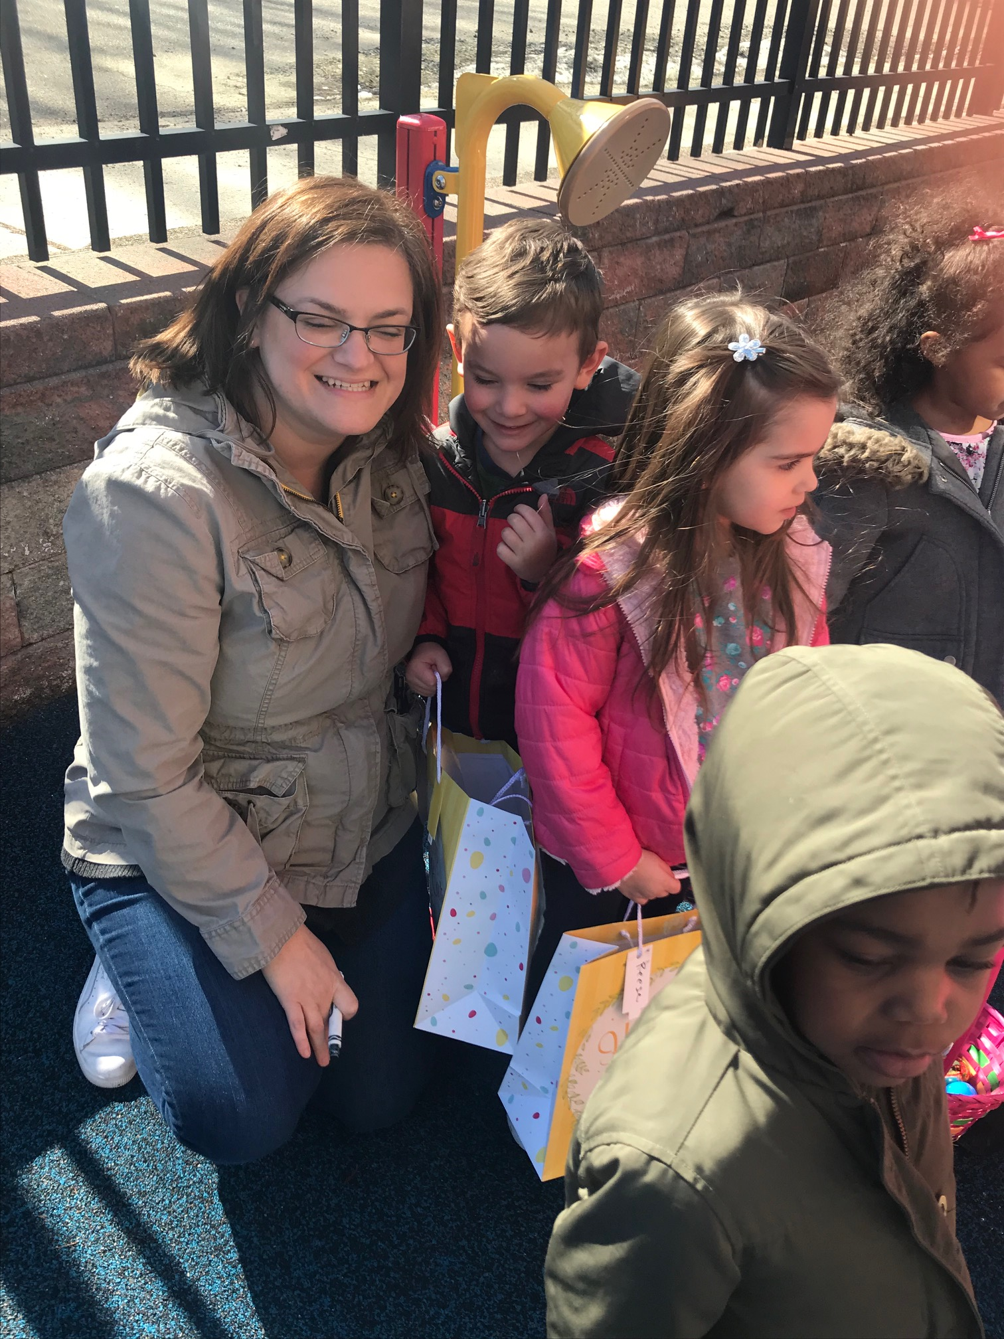
PARENTAL INVOLVEMENT
PARENTS GUILD EXECUTIVE BOARD
CLASS PARENTS
LUNCHTIME VOLUNTEERS
CLASSROOM SPEAKERS
CLASSTRIPS
SHARING IDEAS
WE TRULY HAVE THE BEST OF THE BEST!
Thank you to all of our parents that constantly contribute.
“FUND”RAISING
VS. “FUN”RAISING

Slide 9
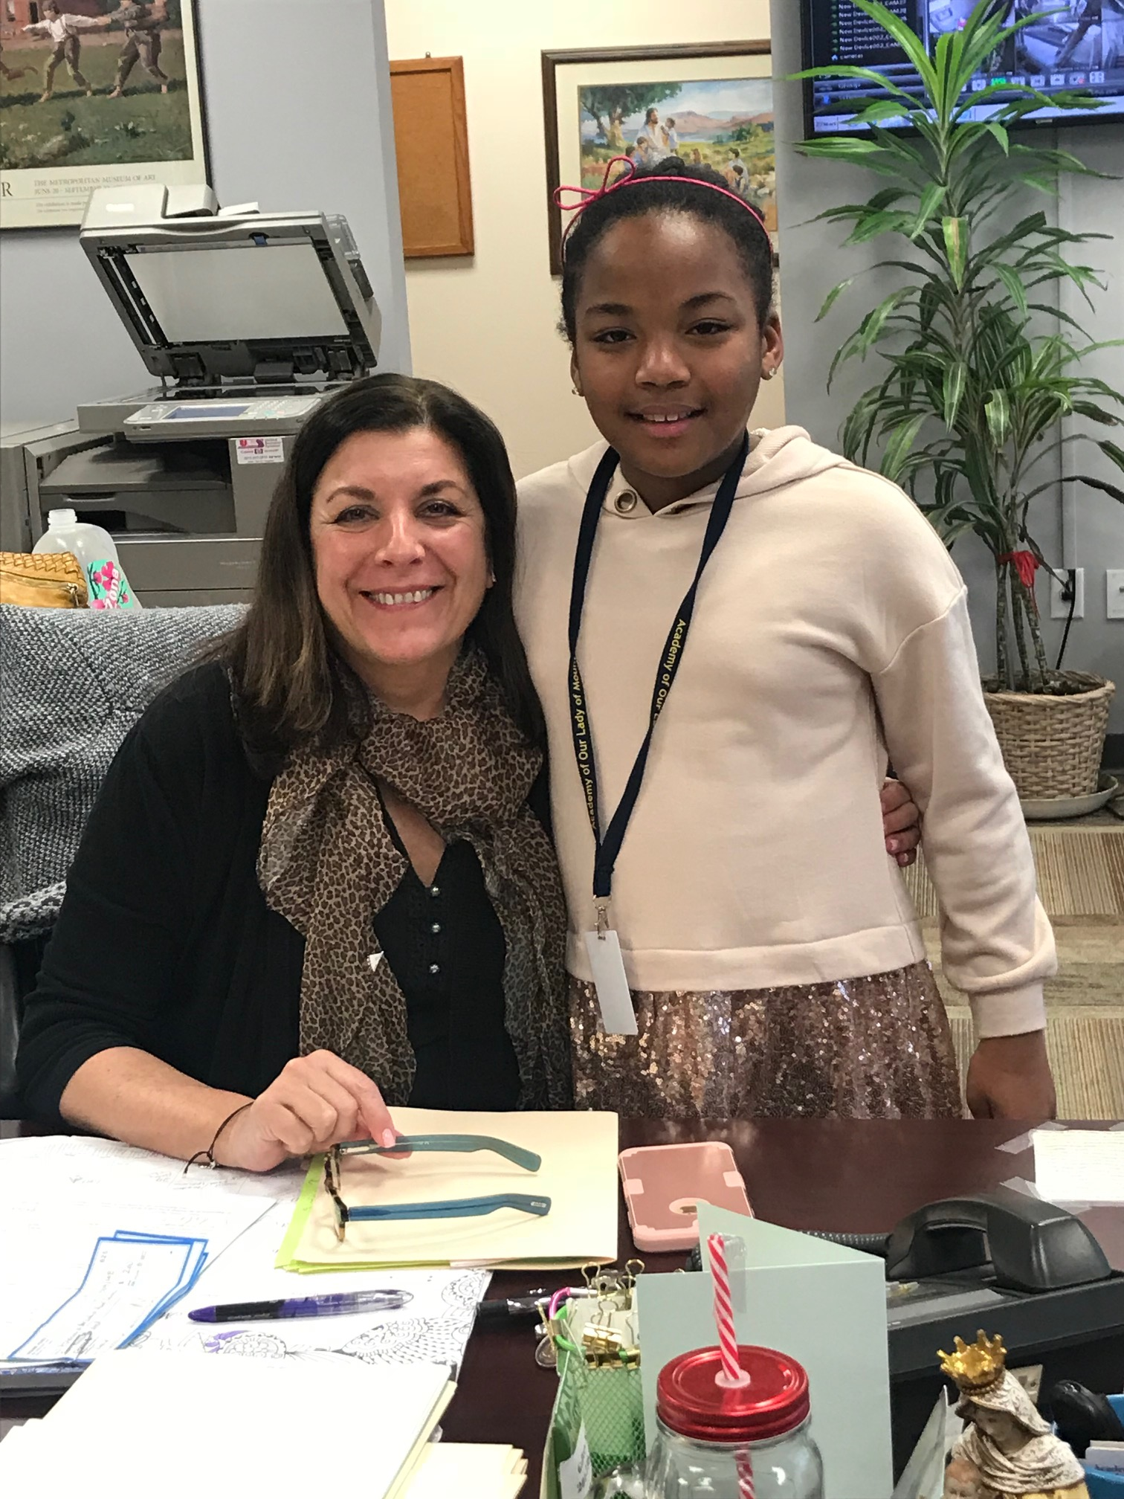
Admissions/ Enrollment
2016-2017: 269 Students
2017-2018: 271 Students
2018-2019: 278 Students will be Registered by the end of the week!

Slide 10
MR. ED MCELROY Facilities/ Campus Upgrades
2016-2018
Early Childhood:
Upgrades to increase Instructional Space
Primary Wing:
Art Room Renovation, Relocation of the “Relish” Religion/Spanish Room, Re-do Closets for Organizational Purposes, Painting Upgrades
Intermediate Department: 4th and 5th Brand New Classrooms
Middle School: 6th, 7th, and 8th Grade Brand New Classrooms

Slide 11
New Parking Lot
Gym Floor Refinishing
Resource Room Creation for Small Group Instruction
Security Upgrades: Cameras/ Additional Locks/ Shades/ Doors / Etc.
Faculty Restroom
Plans for Future:
Primary Wing Renovations
Restrooms
More Small Group Instruction Areas throughout the building

Slide 12
CURRICULUM
RCAN Curriculum Mapping (each subject is on our website)
Math/ ELA/ Technology/ Religion/ Technology
Consistent across the Diocese
Infused with Gospel Values
OLMC Students Take on IOWA Testing in 2018!
Scores will be here shortly
Snapshot of your child’s academic ability in multiple areas
Exceptional Tool to help Academy/Teachers/Parents/Students

Slide 13
Mathematics in Action:
Evaluation of Classroom Materials
Regular Departmental Meetings
Middle School Mathematics Restructure
Partnership with Mathnasium, Englewood
Math Night and Math Madness
Structured use of IXL/ Mathletics
Grade Advanced Mathematics Classes for Grades 4 and 5
Weekly Skills and Drills Classes
Introduction of IXL in Early Childhood
Lab Learner Success:
Blown away by the content that our student learn.
Hands-On Approach to learning science concepts
Other Schools are joining on the Lab Learner Experience
This Curricular Decision brought our Student success much higher in the area of Science
Science Fair is on the horizon!!
Reading and Writing:
Evaluation of Classroom Materials
Increasing Additional Online resources for 2018-2019 for all grades
2018-2019: Piloting RAZKids Guided Reading Program for a more differentiated approach.
iRISE Program (Independent Reading)
Increased Writing Across the Curriculum
Social Studies:
2 years of the new SS Program.
The students are learning more content and getting connected with the world around them.
SMART Technologies increases the “Worldly Experience”

Slide 14
TECHNOLOGY Advancements
iPads
MacBooks
SMART boards
3D Printers
“Code”apillars
We-Do Legos
Snap Circuits
IXL
iMovie
Prezi
Mathletics
RazKids
SMART Notebook
Google Classroom
Go Noodle
Learning without Tears
Google LitTrips

Slide 15
OLMC Arts and enrichment
Spanish
Carmel Cares
Music
Theater
Art
MakerSpace
Coding/Robotics
Phys. Ed/Health
Cultural Experiences
Class Trips
Yoga
Golf/Tennis
2nd Grade Clinic
Volleyball
Cooking
Get Fit
Berlitz
Chess
Book Club
Please bring forth any ideas that you have for the upcoming year!

Slide 16
FINANCES
Mrs. Peggy Rizzo: Our New RCAN Business Manager ( rizzomar@rcan.org )
OLMC profit and loss statement through February 28, 2018 shows us staying very close to what we budgeted for this year in all areas, which puts us in the position we hoped for so we can complete the improvements that we have planned.

Slide 17
There is a small difference in Fundraising Revenue budgeted ( at this point in time)… But there is surely a way you can help!
OLMC has seen a savings due to a cut in Fundraising Expense and we still have our next BIG EVENT:
The Sweetheart Dance coming up, so our fundraising efforts should be right on point for the year. Please come enjoy the night to contribute to our Fundraising Efforts.
See. Mrs. Poon for Details!

Slide 18
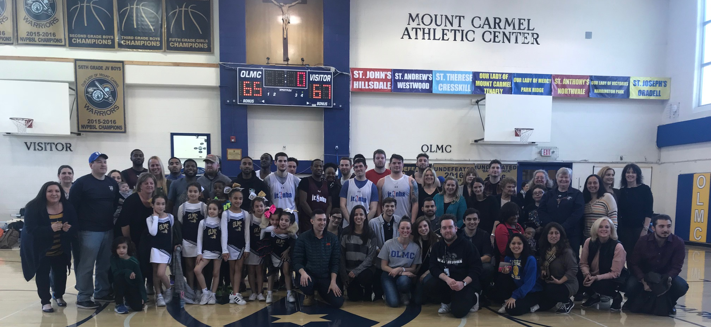
Thank you as always for being so generous to our children.
As in the past, we are self sustaining and are able to generate a profit to ensure that there will be future Warriors for many years.

Slide 19
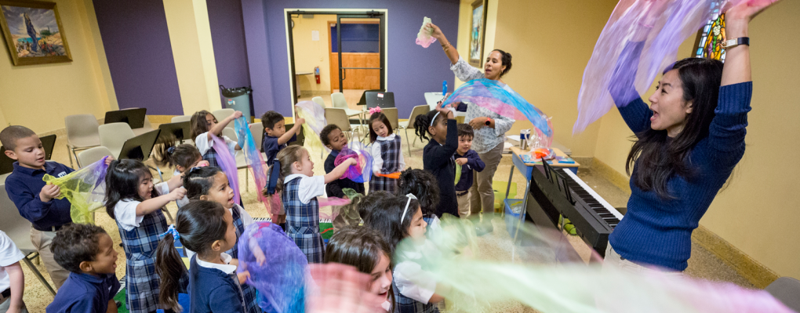
2018-2019 Personnel changes THANK YOU FOR ALL THAT YOU HAVE DONE FOR OLMC!

Slide 20
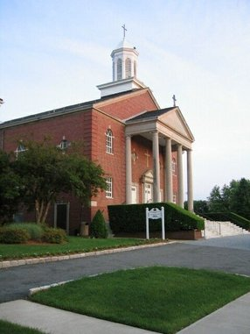
FATHER DAN O’NEILL
I would like to thank Father Dan and the Parish Staff for their constant support and dedication to making the Academy an amazing community to pray, love, and serve. We at OLMC, are committed to working together for the best interest of you and your children.

Slide 21
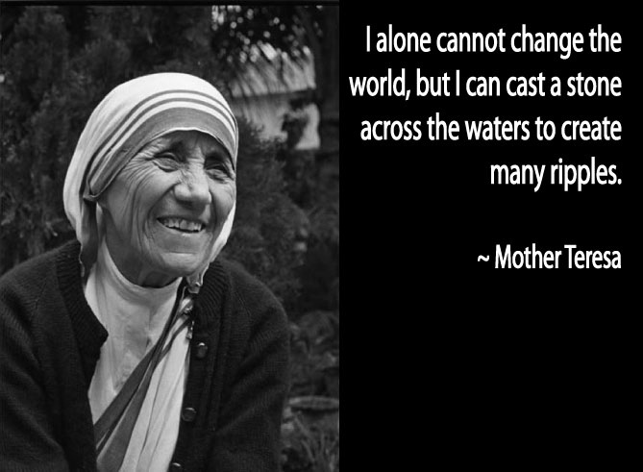

Slide 22
God Bless each of you!
Thanking you for choosing OLMC for your child’s early childhood and elementary education years.
We are blessed to have you as part of Our Mount Carmel family.
God Bless.

